Slide 1

Model Development

Slide 2
Objectives
Apply polynomial regression techniques to Python
Describe the use of R-squared and MSE for in-sample evaluation
Apply prediction and decision making to Python model creation
Model Development

Slide 3
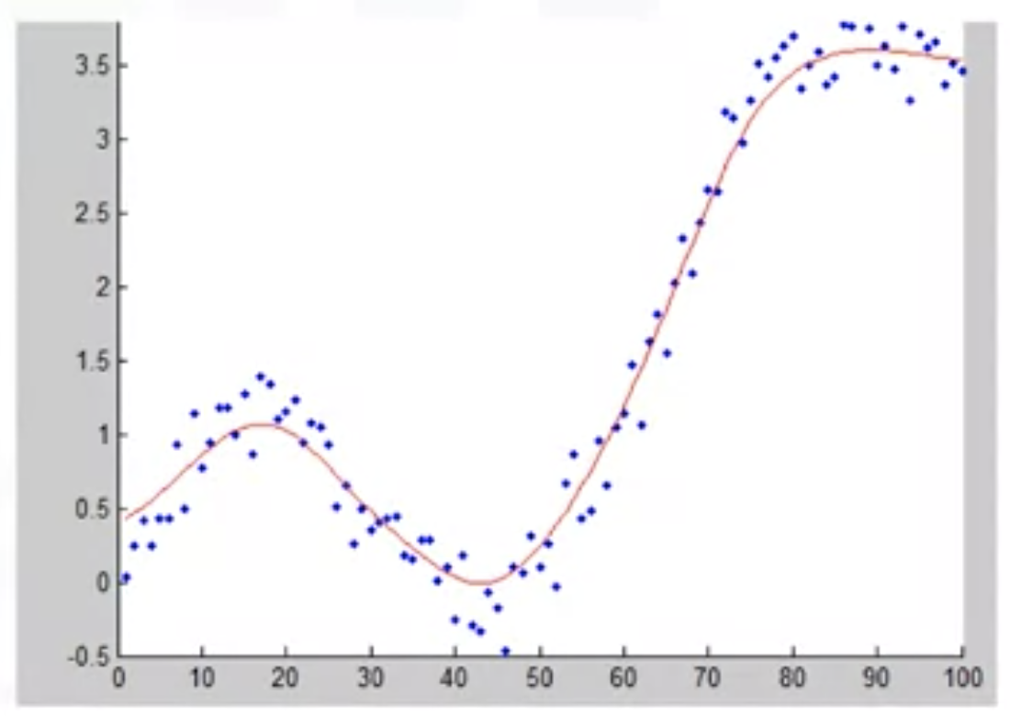
Polynomial Regression and Pipelines
What do we do when a linear model is not the best fit for our data?
Polynomial regression is a special case of general linear regression.
Useful for describing curvilinear relationship
Curvilinear relationships
  By squaring or setting higher- order terms of the predict variables
Model Development

Slide 4
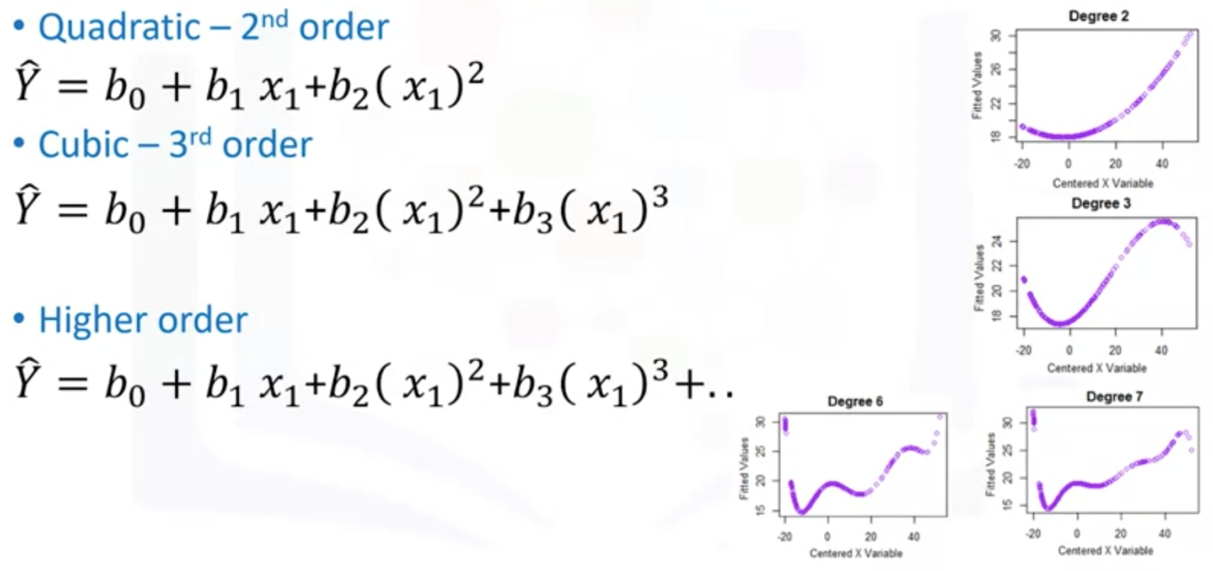
Polynomial Regression and Pipelines
Model Development

Slide 5
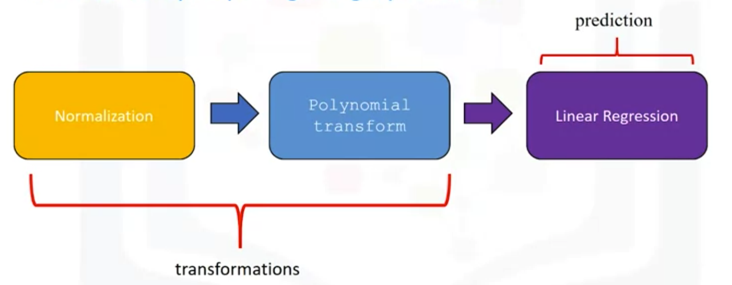
Polynomial Regression and Pipelines
There are many steps to getting a prediction:
  Normalization
  Polynomial transform
  Linear regression
Pipeline sequentially perform a series of transformations.
The last step carries out a prediction.
Model Development

Slide 6
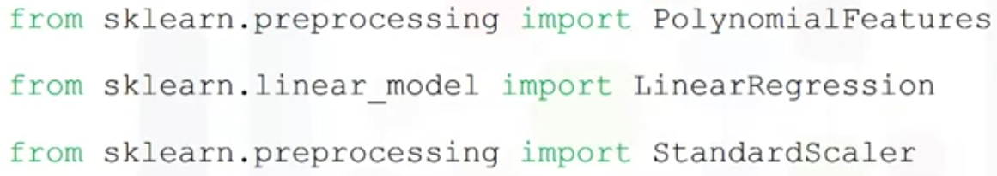
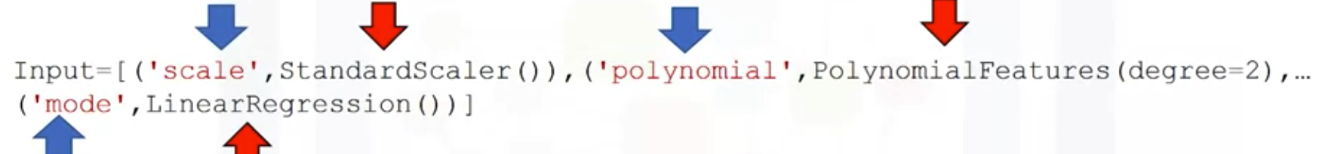

Polynomial Regression and Pipelines
Pipelines
  Import libs
  We create a list of tuples:
    First element in the tuple contains the name of the estimator model.
    Second element contains model constructor.
  Input the list in the pipeline constructor.
Model Development

Slide 7
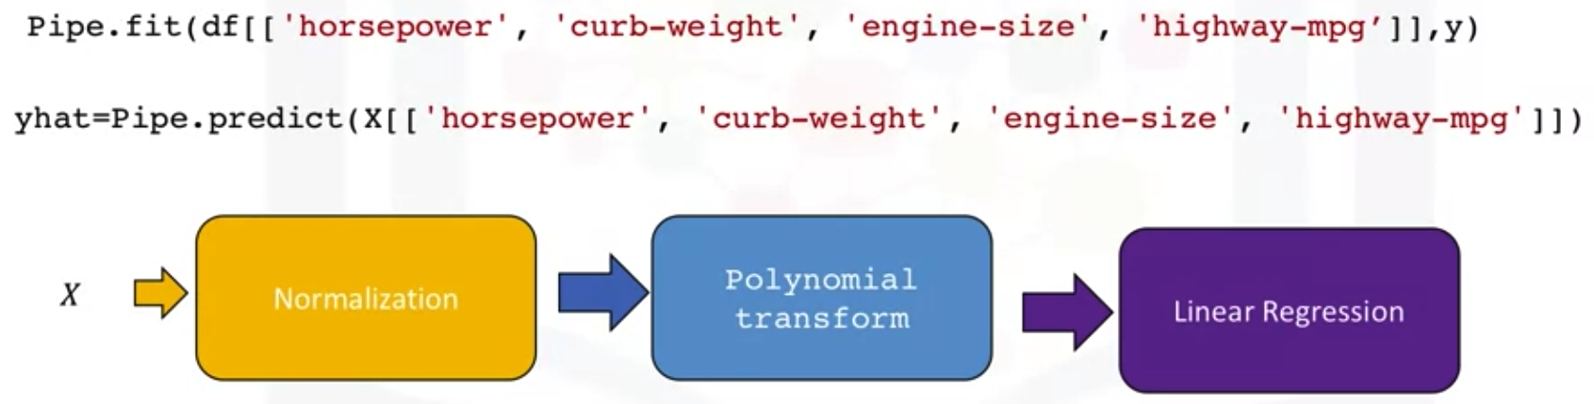
Polynomial Regression and Pipelines
We can train the pipeline object
Model Development

Slide 8
Measures for In-Sample Evaluation
A way to numerically determine how good the model fits on our data.
Two important measures:
  Mean Square Error (MSE): the difference between the actual value y and the predicted value yhat then square it.
  R-squared: determine how close the data is to the fitted regression line
Model Development

Slide 9
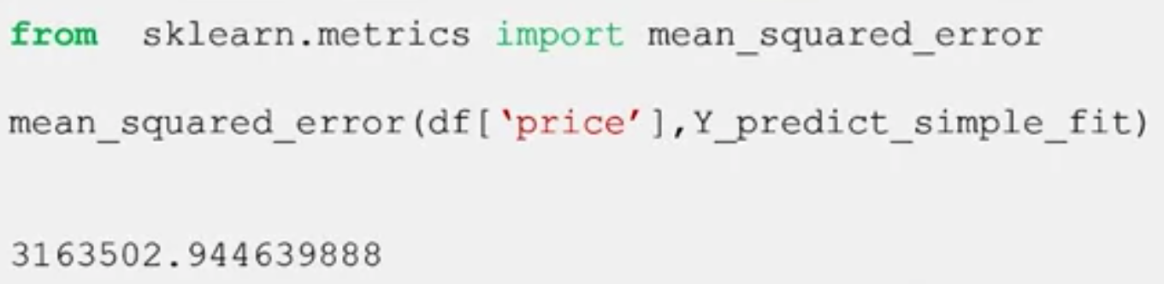
Measures for In-Sample Evaluation
Mean Square Error
  Find the difference between the actual value y and the predicted value yhat then square it
  In python we can measure the MSE:
Model Development

Slide 10
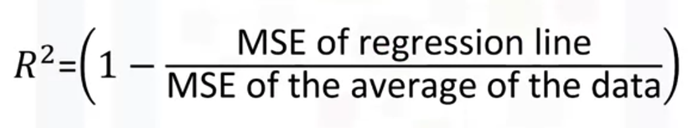
Measures for In-Sample Evaluation
R- Quares/ R^2
  The coefficient of determination or R squared (R^2)
  Is a measure to determine how close the data is to the fitted regression line
  R^2: the percentage of variation of the target variable( Y) that is explained by the linear model.
  Think about it as comparing a regression model to a simple model, i.e., the mean of the data points.
Model Development

Slide 11
Prediction and Decision Making
How can we determine if our model is correct?
To determine final best fit, we look at a comnination of:
  The predicted values make sense
  Visualization
  Numerical measures for evaluation
  Comparing models
Model Development

Slide 12
Summary
Apply polynomial regression techniques to Python
Describe the use of R-squared and MSE for in-sample evaluation
Apply prediction and decision making to Python model creation
Model Development

Slide 13
Q & A
Model Development

